Slide 1
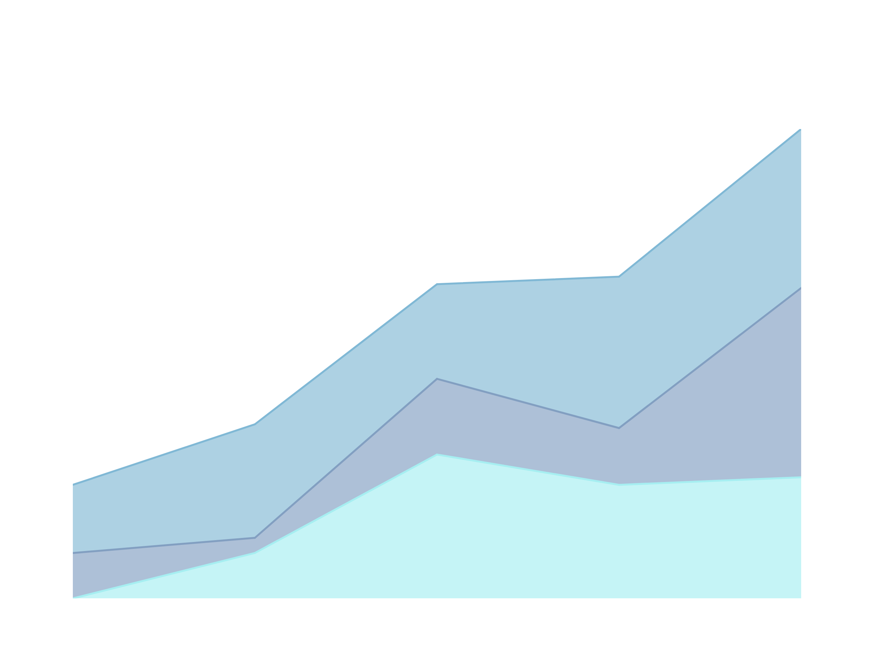
IMPROVING EMPLOYEE RETENTION BY PREDICTING EMPLOYEE ATTRITION USING MACHINE LEARNING
FASYA MELIA INDAHSARI

Slide 2
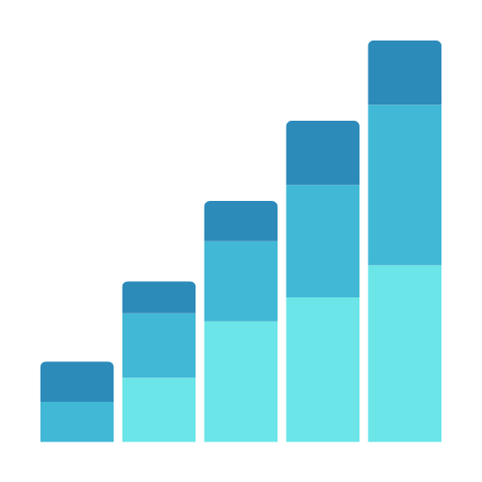
INTRODUCTION
Objective: Analyze employee data to predict attrition and improve retention strategies.
Tools & Techniques: Python, Pandas, Matplotlib, Seaborn, Machine Learning
Prevent more employees from resigning by identifying those likely to leave and implementing targeted retention strategies to keep them within the company.

Slide 3
EDA AND DATA PREPROCESSING
Missing Values Detected:
  Columns Affected: Kepuasan Pelanggan, Jumlah Keikutsertaan Projek, Keterlambatan Sebulan Terakhir, Jumlah Ketidakhadiran, Alasan Resign, Ikut Program LOP.
Handling Missing Values:
  Kepuasan Pelanggan, Jumlah Keikutsertaan Projek, Keterlambatan Sebulan Terakhir, Jumlah Ketidakhadiran: Replaced null values with the median to avoid the influence of outliers.
  Alasan Resign: Replaced null values with the modus to maintain data distribution.
  Ikut Program LOP: Dropped the column due to excessive null values (89.90%).

Slide 4
EDA AND DATA PREPROCESSING
Data Cleaning:
  No duplicate values found.
  Converted 'yes' to 1 in the column PernahBekerja.
  Replaced '-' with Belum Menikah in Status Pernikahan since it was the most frequent value.
  Changed Product Design (UI & UX) to masih bekerja in AlasanResign based on frequency.
  Dropped the PernahBekerja column due to it having only one unique value (constant).

Slide 5
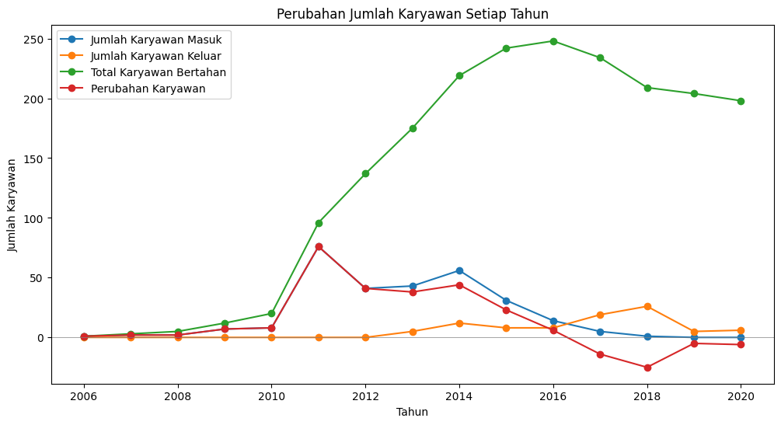
EDA AND DATA PREPROCESSING
  High Retention Rate: The majority of employees have stayed with the company, with fewer resignations overall.
  2011: Significant increase in new hires (76 employees) due to a major recruitment drive.
  2014: Another increase in new hires, but accompanied by a higher resignation rate.
  2016: The highest total number of employees, reaching 248.
  2017-2018: Notable spike in employee resignations during these years.

Slide 6
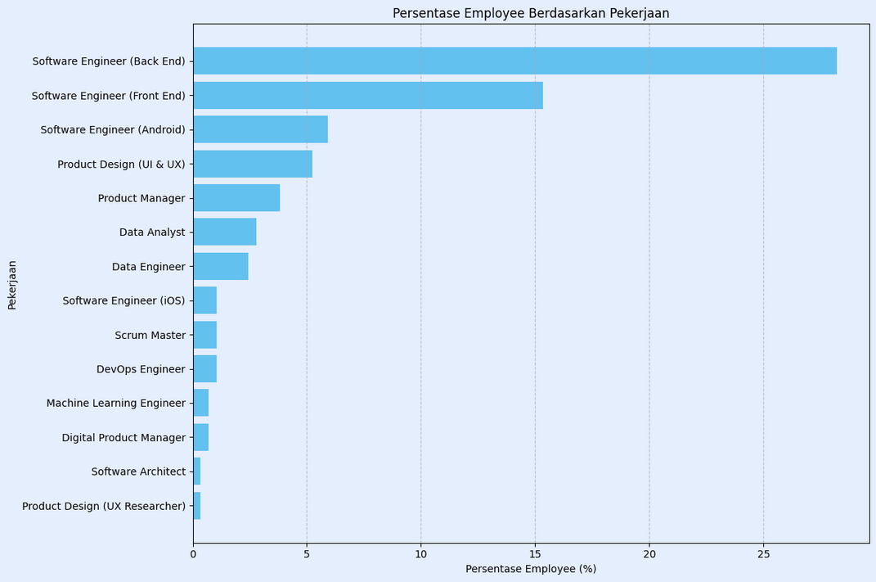
EMPLOYEE DISTRIBUTION BY ROLE (PEKERJAAN)
Top Roles:
  Software Engineer (Back End): Highest percentage of employees, over 25%.
  Software Engineer (Front End): Second largest group, around 15%.
  Software Engineer (Android): Third largest, contributing to a significant portion of the workforce.
Design and Product Roles:
  Product Design (UI & UX): Fourth highest, reflecting the importance of design in the company.
  Product Manager: Important role, though fewer in number compared to engineering positions.
  Other Technical Roles:
  Data Analyst & Data Engineer: Moderate representation, highlighting the company's focus on data-driven decisions.
  Software Engineer (iOS): Smaller group, indicating a niche area of focus.
Specialized Roles:
  Scrum Master, DevOps Engineer, Machine Learning Engineer: Lower percentages, representing specialized support functions.
  Digital Product Manager, Software Architect, Product Design (UX Researcher): Least represented roles, indicating highly specialized positions.

Slide 7
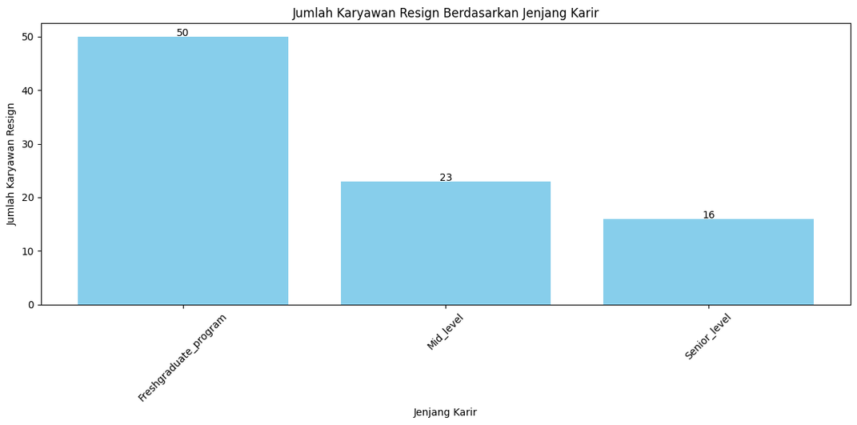
EMPLOYEE RESIGNATIONS BY CAREER LEVEL (JENJANGKARIR)
  Fresh Graduates show the highest resignation rates, often due to job mismatches where roles don't align with their skills or expectations. They might also face unmet expectations regarding growth opportunities, benefits, and work environment, coupled with the challenge of adjusting from academic to professional life.
  Mid-Level Employees rank second in resignation rates. Many in this group seek faster career progression and new challenges, often leaving if they can't find these within the company. Work-life balance is also a significant factor, with some mid-level employees resigning if they can't achieve the balance they need. Additionally, salary expectations play a role, as they may leave if their compensation doesn't reflect their experience.
  Senior-Level Employees have the third highest resignation rate. Career stagnation can lead to dissatisfaction, with some feeling they have reached a plateau. Cultural misalignment might also prompt them to seek environments better suited to their values. Finally, retirement considerations or the desire for less demanding roles might lead senior employees to resign.

Slide 8
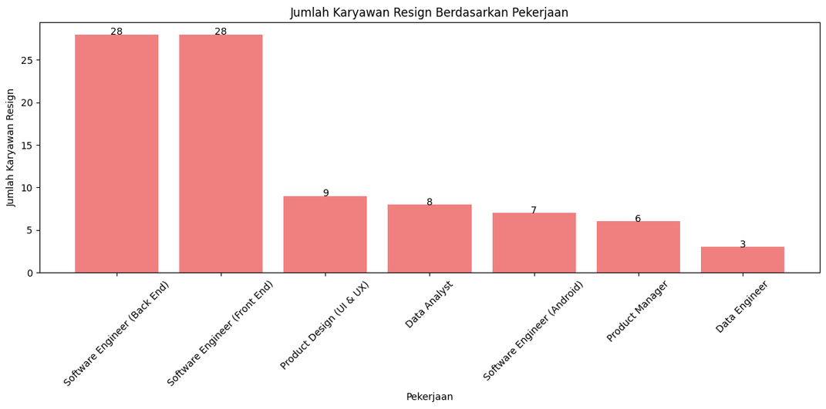
EMPLOYEE RESIGNATION COUNT BY ROLE (PEKERJAAN)
  The chart shows that Software Engineer (Back End) and Software Engineer (Front End) have the highest number of resignations, with 28 people each. This could be due to factors such as high stress levels and workload, which may contribute to their decision to resign.
  Product Design (UI & UX) and Data Analyst follow with 9 and 8 resignations, respectively. Employees in these roles might be experiencing limited career development opportunities or restricted creativity in their work, leading them to seek new opportunities.
  Software Engineer (Android) and Product Manager have 7 and 6 resignations, respectively. In these positions, factors such as inflexible working hours or lack of support for product development could be influencing their decision to leave the company.
  Data Engineer has the fewest resignations, with only 3 people. This may indicate that this role has higher stability, possibly due to its narrower specialization.

Slide 9
BUILDING AN AUTOMATED RESIGNATION BEHAVIOR PREDICTION USING MACHINE LEARNING
Data Splitting:
  Purpose: To separate the dataset into training and testing sets.
  Reason: This allows the model to be trained on one portion of the data (70%) and tested on a separate portion (30%). This is critical for evaluating the model's performance on unseen data.
Normalization:
  Purpose: To scale features using StandardScaler.
  Reason: Normalization ensures that all features contribute equally to the model by scaling them to a similar range, which is especially important for algorithms that rely on distance measures.
Handling Imbalance:
  SMOTE (Synthetic Minority Over-sampling Technique): This technique is used to address any class imbalance in the dataset, which can improve model performance on minority classes.

Slide 10
BUILDING AN AUTOMATED RESIGNATION BEHAVIOR PREDICTION USING MACHINE LEARNING
Model | Acc | Prec | Recall | Time Elapsed
Random Forest | 0.966102 | 1.000000 | 0.888889 | 0.157220
AdaBoost | 0.966102 | 1.000000 | 0.888889 | 5.904674
KNNeighbors | 0.966102 | 1.000000 | 0.888889 | 1.761770
Logistic Regression | 0.898305 | 1.000000 | 0.666667 | 12.171081
XGBoost | 0.813559 | 0.769231 | 0.555556 | 10.557507
Decision Tree | 0.728814 | 0.555556 | 0.555556 | 0.086862
ExtraTress | 0.610169 | 0.368421 | 0.388889 | 0.171677
The Random Forest model is selected as the best overall performer, offering a perfect blend of accuracy, speed, and reliability for predicting employee resignation behavior.

Slide 11
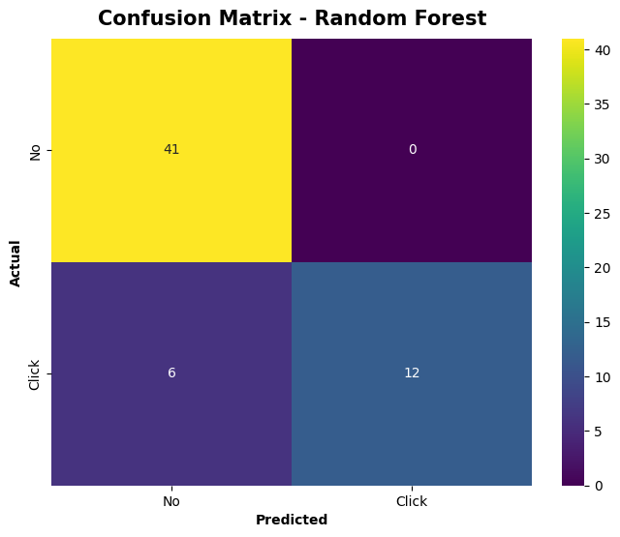
BUILDING AN AUTOMATED RESIGNATION BEHAVIOR PREDICTION USING MACHINE LEARNING
Performance Metrics:
  Accuracy: The high cross-validation accuracy of 94.13% indicates that the model is performing well overall, correctly predicting resignation or non-resignation in the vast majority of cases.
  Precision for Resignation Prediction: A precision of 1.0 (12/12) shows that when the model predicts an employee will resign, it is always correct. This is important in scenarios where false positives (predicting resignation when there is none) are costly, such as unnecessary retention efforts.
  Recall for Resignation Prediction: The recall of 0.67 (12/18) indicates that the model misses 33% of actual resignation cases. This is crucial since failing to predict actual resignations could mean the company loses valuable employees without any prior intervention.
  Specificity for Non-Resignation Prediction: A specificity of 1.0 shows that the model accurately identifies all employees who will not resign.
The model is very reliable when it predicts that an employee will resign. This means you can trust the model's predictions in these cases and perhaps focus on retention strategies for these employees.

Slide 12
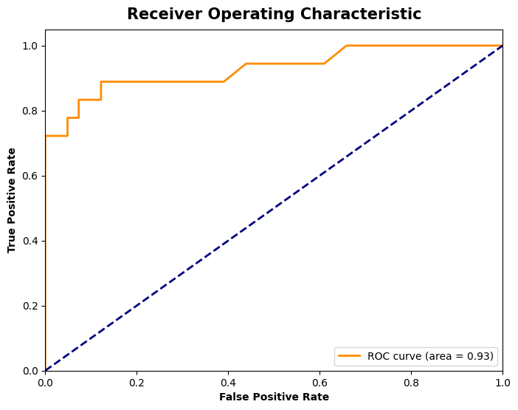
BUILDING AN AUTOMATED RESIGNATION BEHAVIOR PREDICTION USING MACHINE LEARNING
ROC curve dengan AUC sebesar 0.93 menunjukkan bahwa model memiliki performa yang sangat baik dalam membedakan antara kelas positif dan negatif. Model ini sangat efektif dalam memprediksi kelas dengan akurasi tinggi dan memiliki kemampuan diskriminasi yang kuat. Ini berarti model dapat diandalkan untuk aplikasi di mana klasifikasi yang tepat sangat penting.

Slide 13
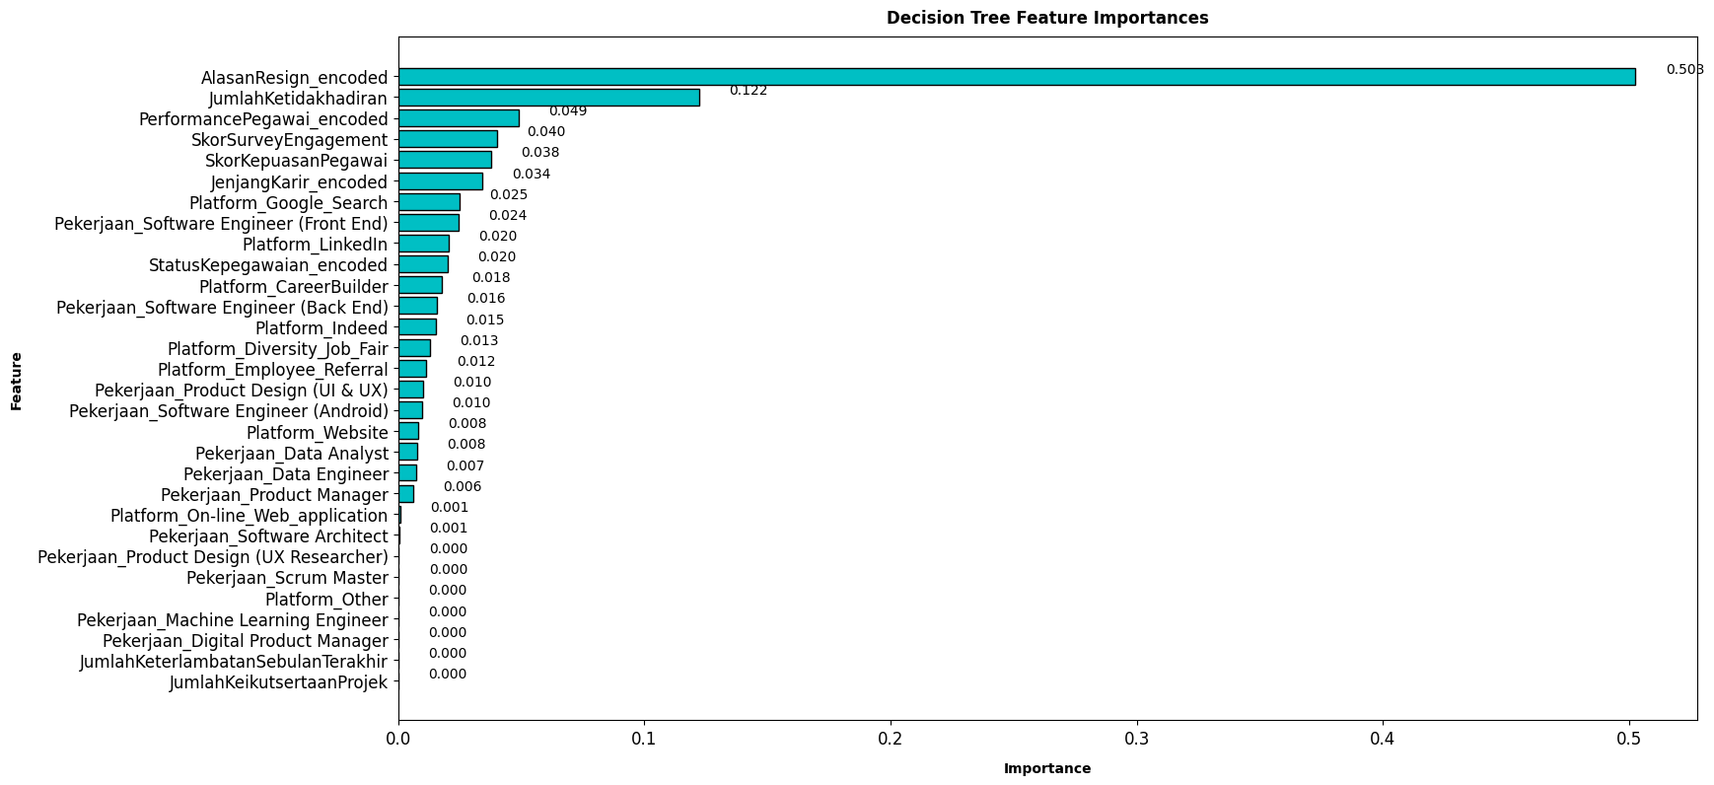
PRESENTING MACHINE LEARNING PRODUCTS TO THE BUSINESS USERS

Slide 14
BUILDING AN AUTOMATED RESIGNATION BEHAVIOR PREDICTION USING MACHINE LEARNING
In a large company like Kimia Farma, understanding the factors influencing employees’ decisions to resign and the platforms used for recruitment is crucial. By applying the Random Forest machine learning model, we analyzed employee data from 2020 to 2023 to uncover valuable insights that can assist the company in its human resource management strategies.
Findings:
  Feature Importance:
    Reason for Resignation: This factor is the most critical determinant in employees' decisions to resign. Therefore, the company needs to deeply understand these reasons to improve the work environment and reduce employee turnover.
  Other Influential Factors:
    Absenteeism: High absenteeism can be an indication of dissatisfaction or other issues that drive employees to resign.
    Employee Performance: Low performance can contribute to the decision to resign, whether due to lack of motivation or pressure from unmet targets.
    Engagement Survey Scores: Low engagement scores reflect a lack of involvement with the company, often leading to resignation.
    Employee Satisfaction Scores: Low satisfaction can indicate dissatisfaction with the work environment, management, or career opportunities.

Slide 15
BUSINESS RECOMMENDATIONS
Targeted Employee Engagement:
  High-Risk Roles: Focus on roles identified as high-risk for resignation, such as Software Engineers. Implement personalized engagement programs, like stress management workshops and flexible work arrangements, to reduce turnover.
Career Development Opportunities:
  Growth-Oriented Roles: For positions like Product Design and Data Analysts, introduce clear career development paths and opportunities for creative projects to keep employees motivated and reduce the likelihood of them seeking opportunities elsewhere.
Work-Life Balance:
  Key Drivers: Address work-life balance concerns, especially in roles with higher workload demands. Offer flexible scheduling or remote work options where possible to increase job satisfaction and reduce resignation rates.
  Introduce a free gym membership program to promote physical and mental well-being. Providing access to fitness facilities encourages employees to maintain a healthy lifestyle, further enhancing their overall work-life balance and commitment to the company.

Slide 16
BUSINESS RECOMMENDATIONS
Continuous Monitoring:
  Proactive Measures: Use the predictive model to continuously monitor employee resignation risk. This allows HR to take proactive measures before employees reach the point of resignation.
Employee Feedback Mechanisms:
  Data-Driven Insights: Regularly collect and analyze employee feedback to understand the underlying reasons behind potential resignations. This feedback should be used to refine the predictive model and improve the accuracy of future predictions.

